Slide 1

NNSampleSize A tool for communicating, determining and documenting sample size in clinical trials
Claus Dethlefsen, Novo Nordisk A/S Steffen Falgreen Larsen, Novo Nordisk A/S Anders Ellern Bilgrau, Seluxit Nynne Holdt-Caspersen, Novo Nordisk A/S Maika Lindkvist Jensen, Novo Nordisk A/S
Notes:
My name is Claus Dethlefsen, and I work at the Danish pharmaceutical company, Novo Nordisk. On behalf of this group of developers, I will present a tool for communicating, determining and documenting sample size in clinical trials. We call the shiny app NNSampleSize.

Slide 2
Disclaimer
Views and opinions expressed are those of the speaker and not necessarily Novo Nordisk
Notes:
Please note my disclaimer, that Views and opinions expressed are those of the speaker and not necessarily Novo Nordisk.

Slide 3

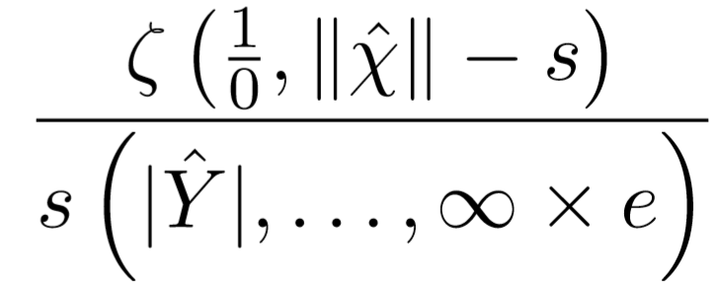
Clinical study
sample size
Notes:
Determining a clinical study sample size is an iterative process. A medic comes to the statistician with a suggestion for trial design and would like us to compute the necessary number of subjects to include in order to show the assumed effects. We get back to the medic which agains comes with new assumptions and calculations will start over again.

Slide 4
Why is sample size determination important? Striking the balance
Un-ethical to expose more than needed – the experimental drug may have unwanted side-effects
Sufficient chance of detecting a clinical relevant effect size
Regulators demand statistical significance to have claims in the label
Un-ethical if unable to detect a clinical relevant effect size
Costly (in terms of time and money) to include too many subjects
Notes:
So why is it important?
On the one hand, regulators demand statistical significans to have claims in the label. This speaks to having ‘enough’ subjects in the trial.
On the other hand, it is costly in terms of time and money to include too many subjects.
We also need to strike a balance regarding ethics. It is un-ethical to expose more than needed – the experimental drug may have unwanted side-effects. But it is also un-ethical if we do not have enough subjects in the trial to determine a clinical relevant effect size.
Finally, we want a sufficient chance for detecting a clinical relevant effect size.

Slide 5
> power.t.test(power = .90, delta = 1, sd = 1.2)
Two-sample t test power calculation
n = 31.25372
delta = 1
sd = 1.2
sig.level = 0.05
power = 0.9
alternative = two.sided
NOTE: n is number in *each* group
Decision Hypothesis | Do not reject | Reject
True | Correct decision | Type 1 error
False | Type 2 error | Correct decision
”1-”
Notes:
In principle, it is fairly easy to determine the sample size
Here is a call to the function power.t.test with a given set of parameters.
In this case with a treatment effect of 1, a standard deviation of 1.2 and a power of 90%, we would need 32 subjects in each of the two groups we compare.
Here we have a significance level of 5%, which is the probability of making a Type 1 error
One minus the power is the probability of making a Type 2 error.

Slide 6
Some types of clinical trials
Parallel group
Cross-over
Treatment A
Treatment A
Treatment A
Placebo
Placebo
Placebo
Duration XX weeks
Randomisation (1:1)
End of treatment
Notes:
Here are two examples of trial designs. To the left is a parallel group design which may terminate either driven by events, or after a certain duration of treatment.
On the right-hand side is a cross-over design, where subjects are randomised into one of two possible sequences of treatments.

Slide 7
In reality, it gets complicated
Trial design influence parameters (inclusion/exclusion criteria, duration of treatment, comparators)
Expected effects and variation
Hypotheses and multiplicity considerations
Expected patterns and handling of missing data
Notes:
In reality, it gets complicated; potentially leading to many iterations in the process
There are many trial design parameters that influence the determination of sample size. This may be inclusion/exclusion criteria (more ill patients may have higher efficacy), the duration of treatment, choice of either placebo or an active treatment comparator.
The expected effects and variation of the endpoint
Hypotheses and how to adjust for multiplicity (that is, controlling the type 1 error although multiple tests are reported)
The amount and reason for missing data

Slide 8
Key features of NNSampleSize
Access control only statistician and selected stakeholders have access to study sample size
Ability to create several scenarios to be compared
Dynamic visualisation
Autogeneration of documentation
Reproducability
Traceability
Transparency
Notes:
The key features of the shiny app NNSampleSize is
* we want access control so that only selected stakeholders have access to the sample size. This may be confidential – also within the company
* we want the ability to use dynamic interactive visualisations and where it is possible to compare several scenarios
* and then we want to auto-generate documentation to ensure reproducability, traceability and transparency. And when assumptions change, it is easy to update the documentation.

Slide 9
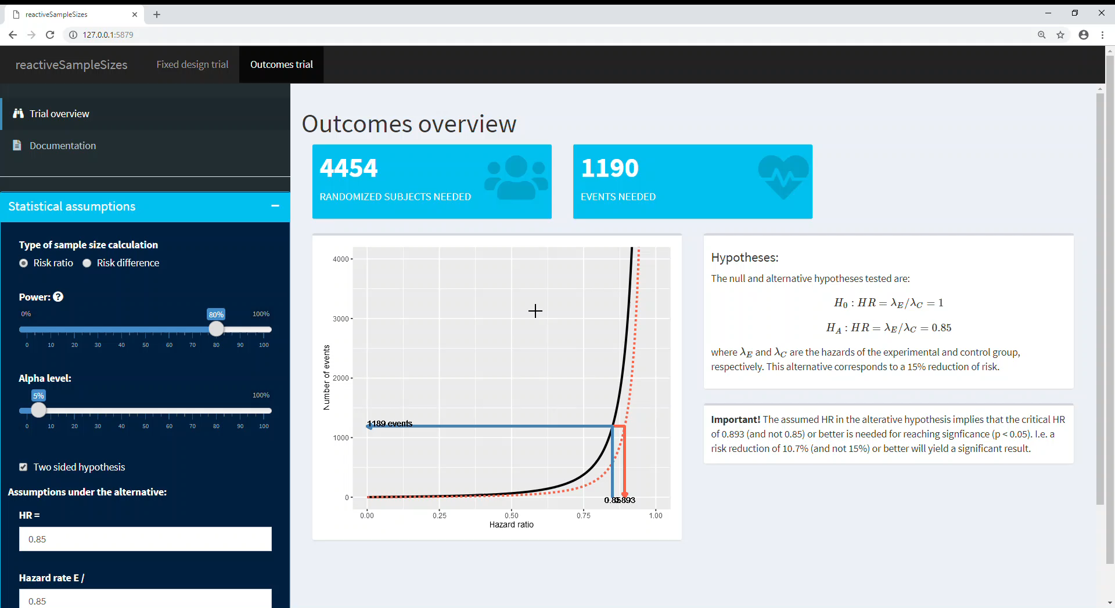
Notes:
Here is a demonstration of a prototype of the shiny app NNSampleSize
In this example, it is an event-driven trial where we can adjust parameters on the left-hand side and immidiately see the results on the right-hand side. At the top you see the subjects needed to be randomised and the number of events needed.

Slide 10
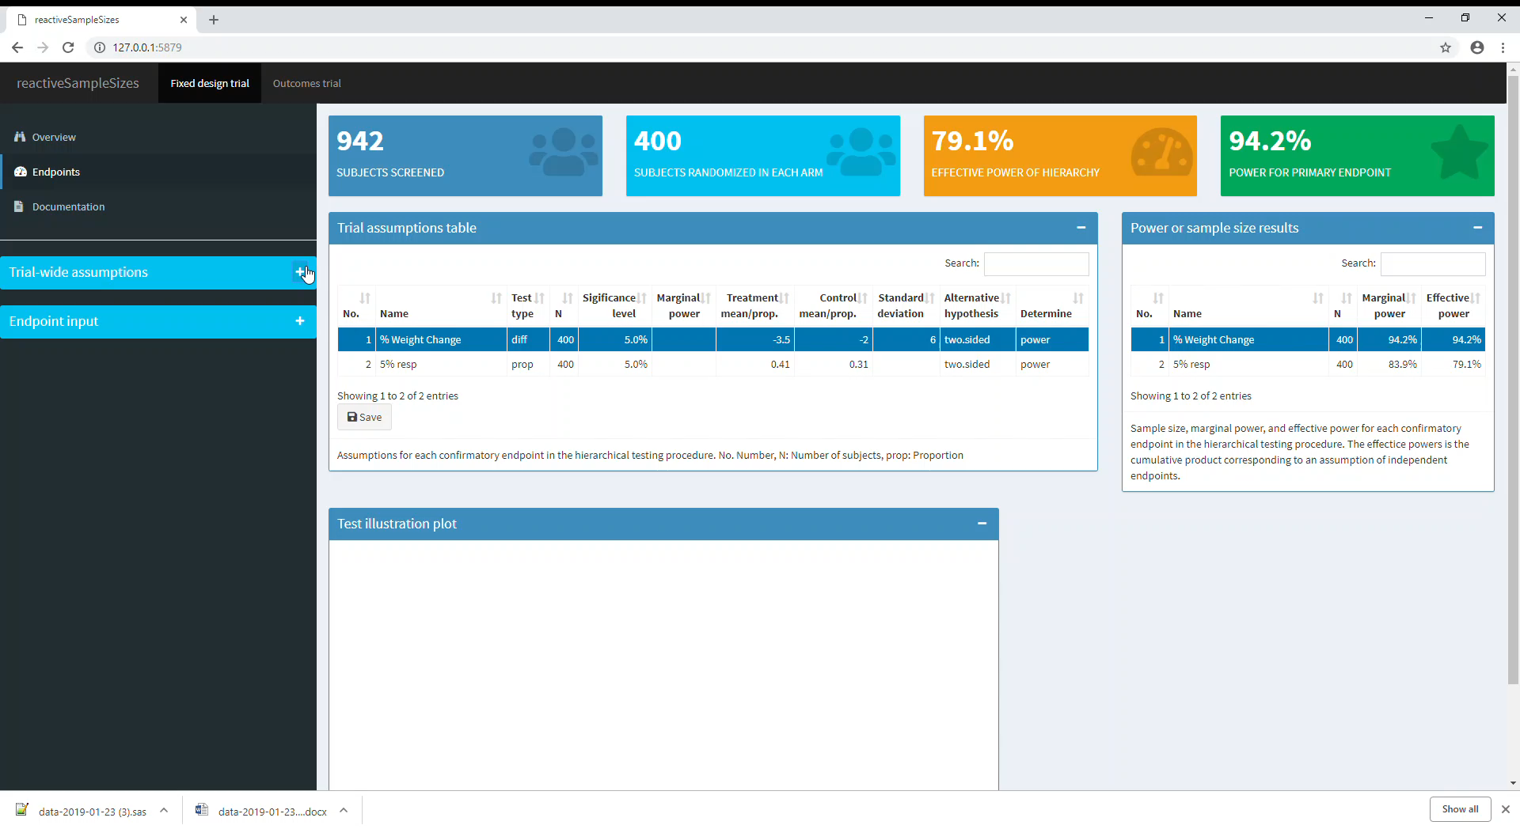
Notes:
Another example is a parallel group design with two endpoints to be tested using a hierarchial testing procedure that preseves the type 1 error to 5%.
It is possible to change parameters and immidiately see how it changes the number of subjects to be screened and randomised. Also the power for achieving superiority in both endpoints and the power for the primary endpoint is shown.

Slide 11
Source code available
NNpackages/NNSampleSize (github.com)
Notes:
Thank you for your attention. The source code for our prototype app is available on GitHub.

